Slide 1
INST 414: Data Science Techniques Lecture 2a Probability Basics

Slide 2
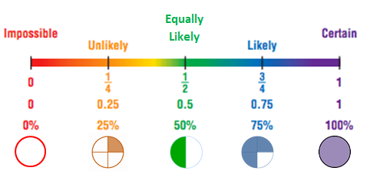
What is Probability?
Probability measures the likelihood of an event occurring
Range: 0 (impossible) to 1 (certain)
Formula:
P(Event) = Number of favorable outcomes / Number of all outcomes
Source

Slide 3
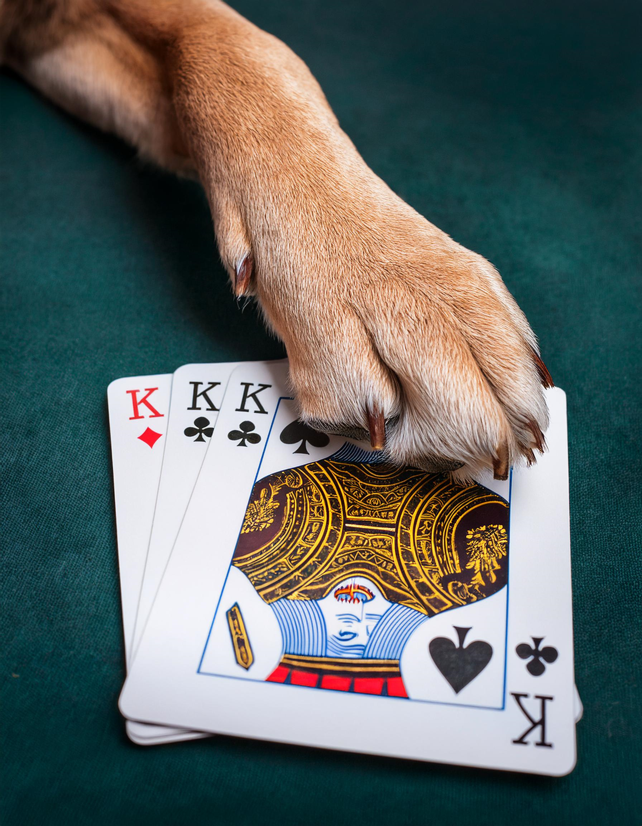
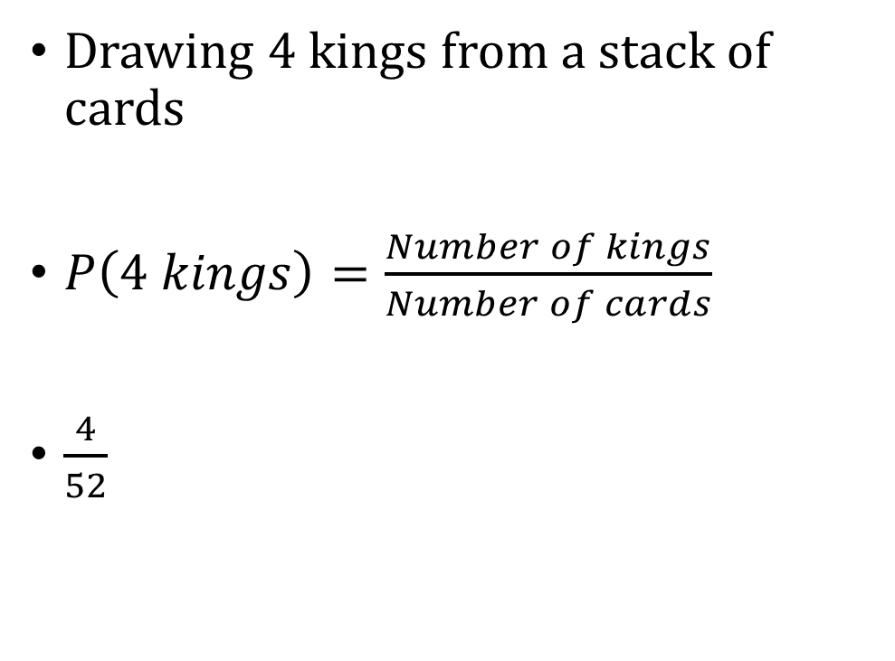
Example
Drawing 4 kings from a stack of cards
$P\left(4 kings\right)=\frac{Number of kings}{Number of cards}$
$\frac{4}{52}$

Slide 4
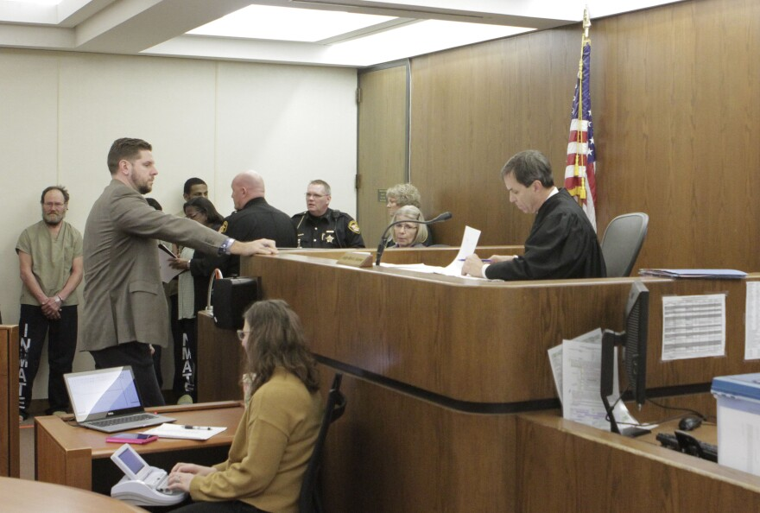
Probability in the Real World
Context: Bail/Pretrial
When a person gets arrested, they go in front of a judge who decides to detain or release
Decision is based on flight or public safety risk:
Will the defendant be re-arrested during this pretrial period?
Will the defendant not show up at a future court date?
Both of these questions are essentially predictions

Slide 5
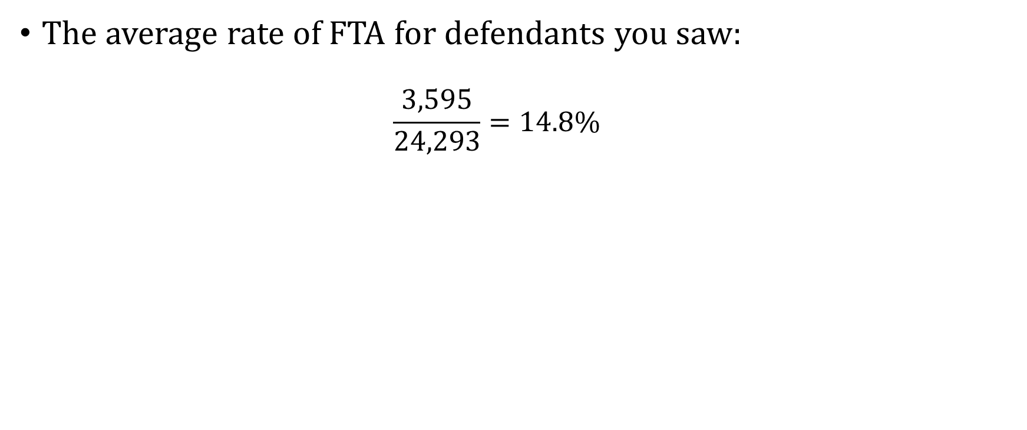
The Overall FTA Rate
The average rate of FTA for defendants you saw:
$$\frac{3,595}{24,293}=14.8\%$$

Slide 6
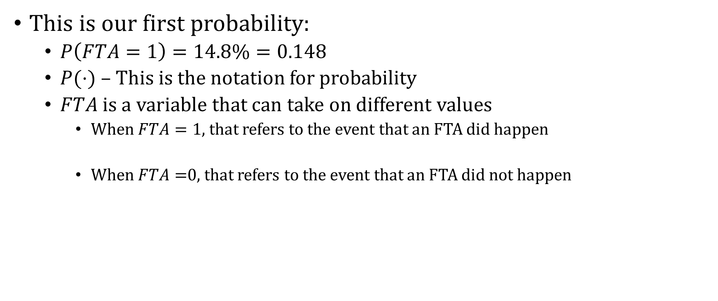
The Overall FTA Rate
This is our first probability:
$P\left(FTA=1\right)=14.8\%=0.148$
$P(⋅)$ – This is the notation for probability
$FTA$ is a variable that can take on different values
When $FTA=1$, that refers to the event that an FTA did happen
When $FTA=$0, that refers to the event that an FTA did not happen

Slide 7
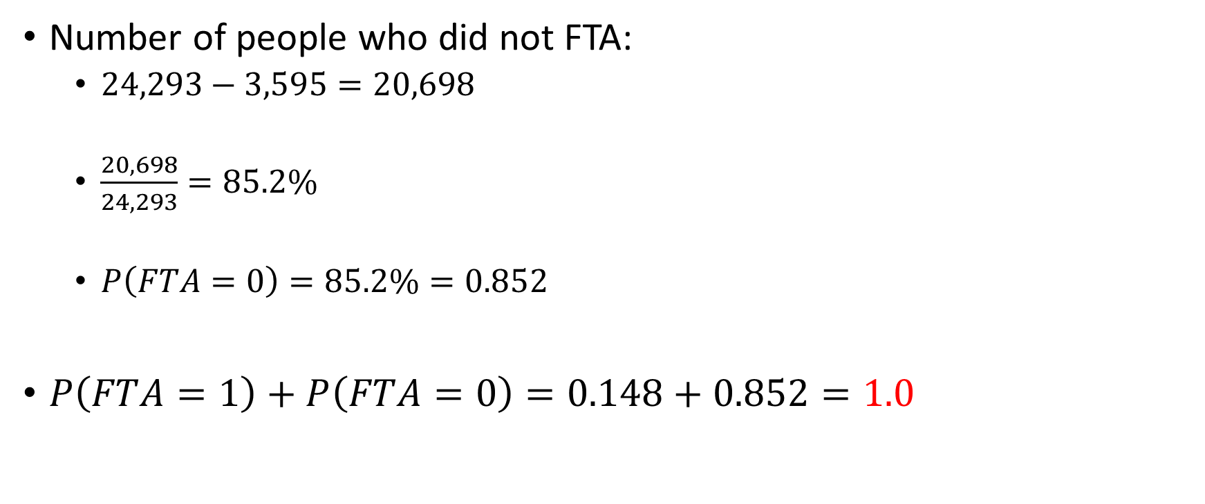
What Is the Chance of No FTA?
Number of people who did not FTA:
$24,293−3,595=20,698$
$\frac{20,698}{24,293}=85.2\%$
$P\left(FTA=0\right)=85.2\%=0.852$
$P\left(FTA=1\right)+P\left(FTA=0\right)=0.148+0.852=1.0$

Slide 8
Rules of Probability
Rule: The sum of the probabilities of “mutually exclusive” outcomes equals one
Mutually exclusive means that the events can’t happen at the same time:
A person can’t both FTA and not FTA for a court appearance

Slide 9
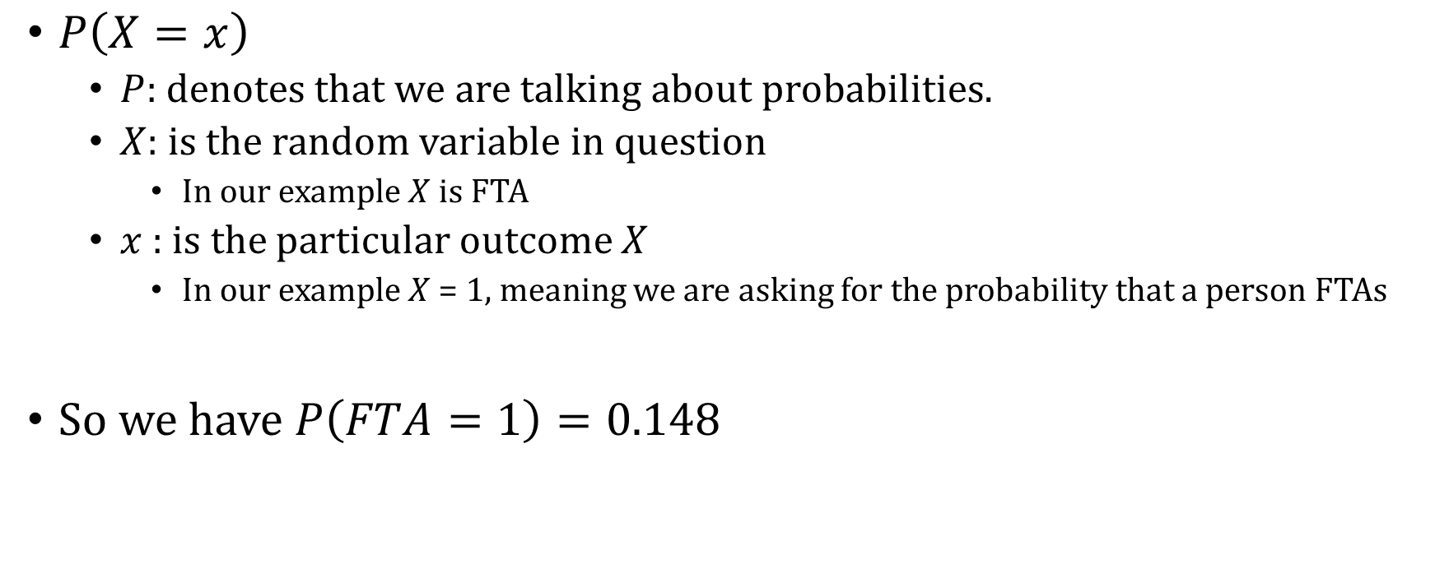
Notation We Will Use
$P\left(X=x\right)$
$P:$ denotes that we are talking about probabilities.
$X:$ is the random variable in question
In our example $X$ is FTA
$x$ : is the particular outcome $X$
In our example $X$ = 1, meaning we are asking for the probability that a person FTAs
So we have $P\left(FTA=1\right)=0.148$

Slide 10

Random Variables and Events
A random variable – uncertain value (result of a random process)
Example of variables that are not random
Yesterday’s weather
Your weight when you were born
Example of variables that are random
Tomorrow’s weather
Height of child in 5 years

Slide 11
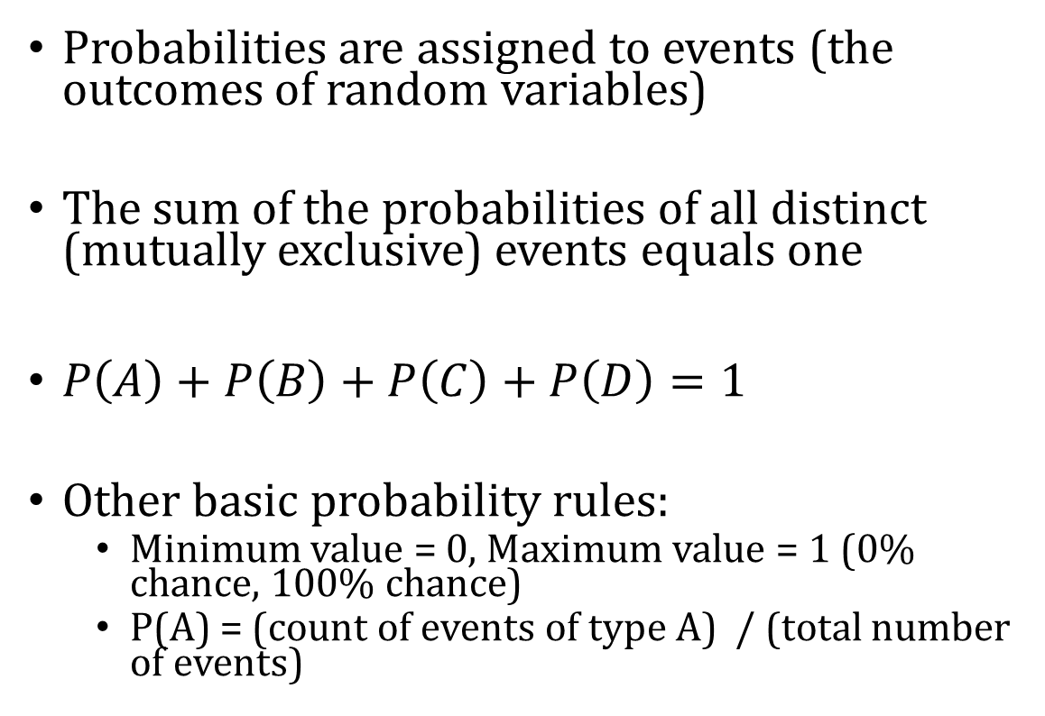
Events
Probabilities are assigned to events (the outcomes of random variables)
The sum of the probabilities of all distinct (mutually exclusive) events equals one
$P\left(A\right)+P\left(B\right)+P\left(C\right)+P\left(D\right)=1$
Other basic probability rules:
Minimum value = 0, Maximum value = 1 (0% chance, 100% chance)
P(A) = (count of events of type A) / (total number of events)
A
B
C
D

Slide 12
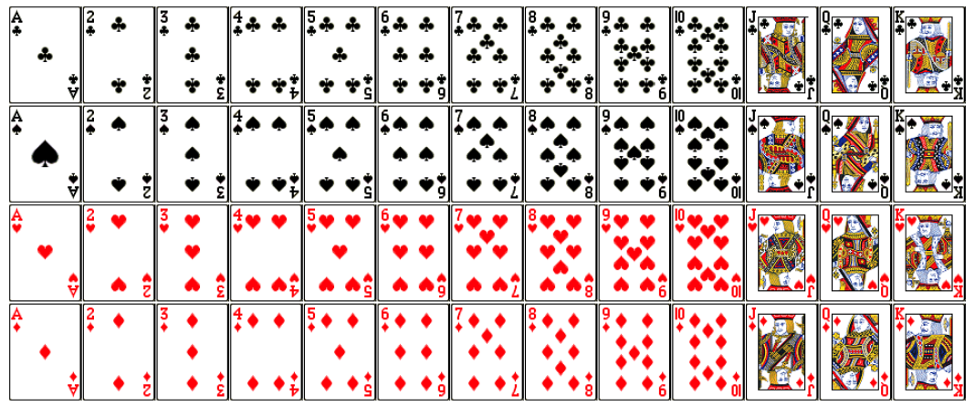
“Event Space”
What are all of the distinct events that could happen when selecting a card from a deck?

Slide 13
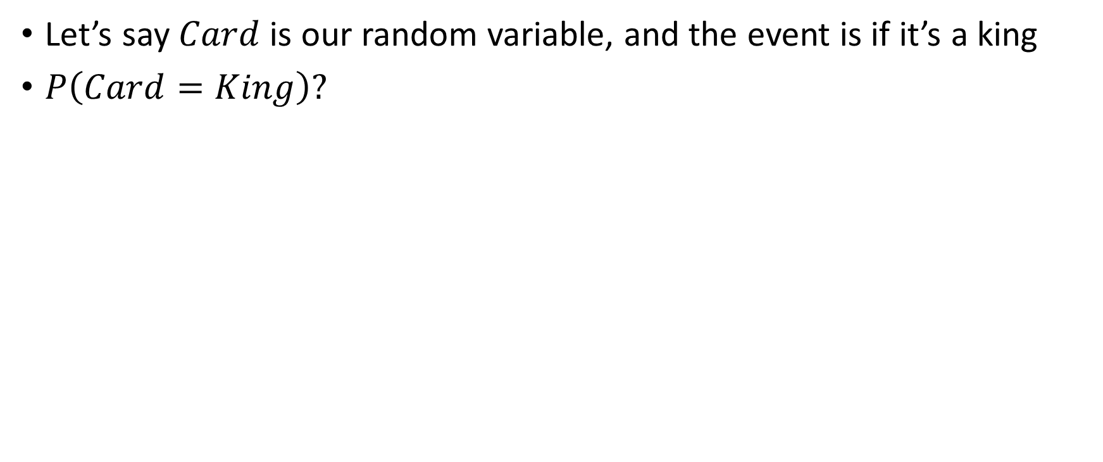
Event Space
Let’s say $Card$ is our random variable, and the event is if it’s a king
$P\left(Card=King\right)?$

Slide 14
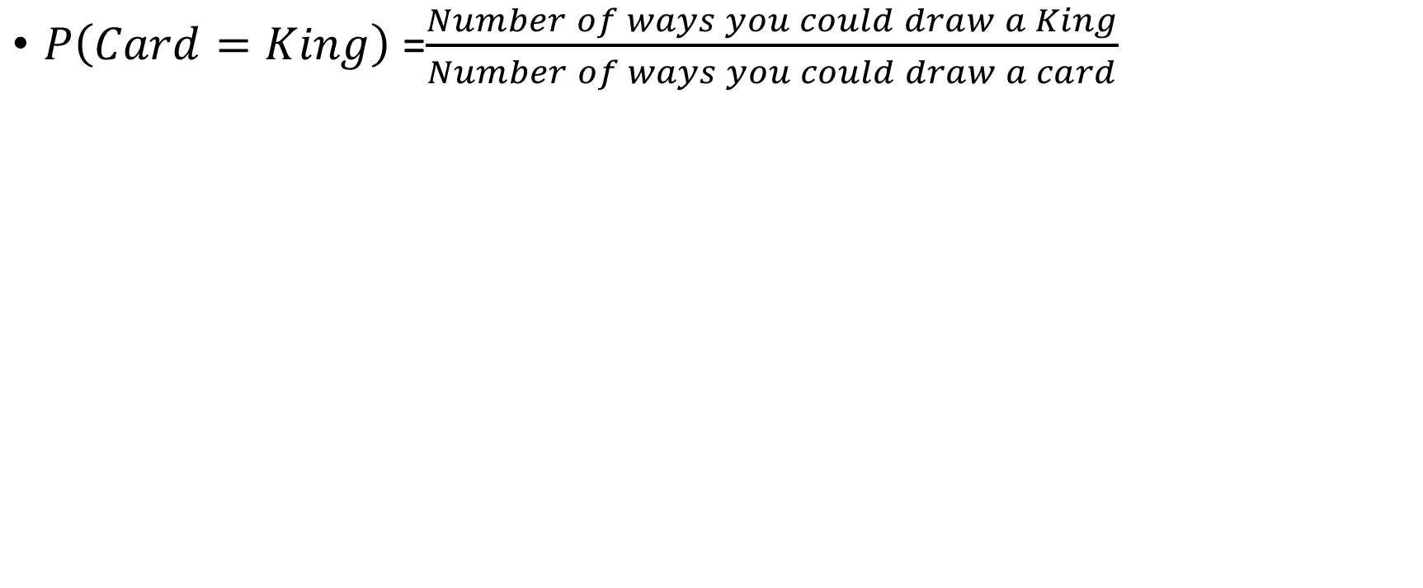
Event Space
$P\left(Card=King\right)$=$\frac{Number of ways you could draw a King}{Number of ways you could draw a card}$

Slide 15
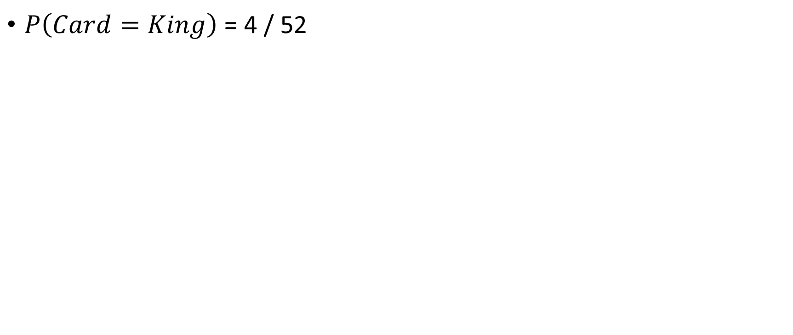
Event Space
$P\left(Card=King\right)$ = 4 / 52

Slide 16
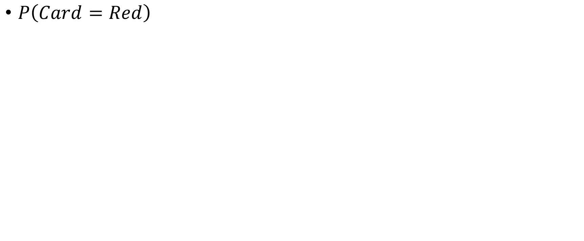
Event Space
$P\left(Card=Red\right)$

Slide 17
Event Space
$P\left(Card=Red\right)$

Slide 18
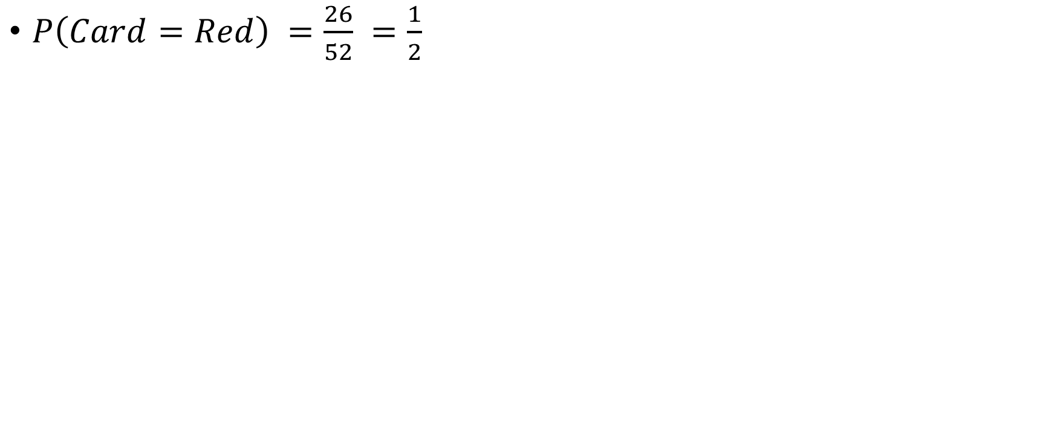
Event Space
$P\left(Card=Red\right) =\frac{26}{52} =\frac{1}{2}$

Slide 19
Event Space
$P\left(Card=Red\right)$

Slide 20
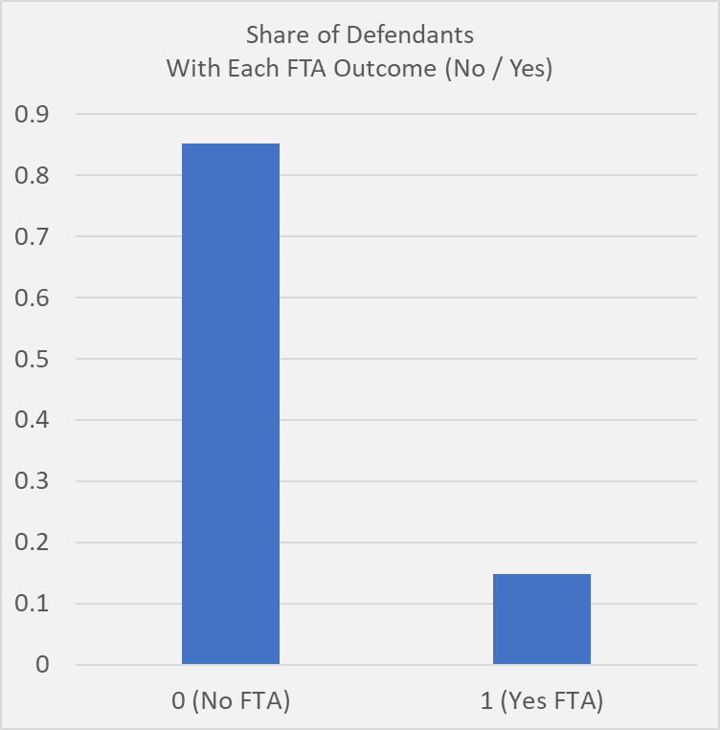
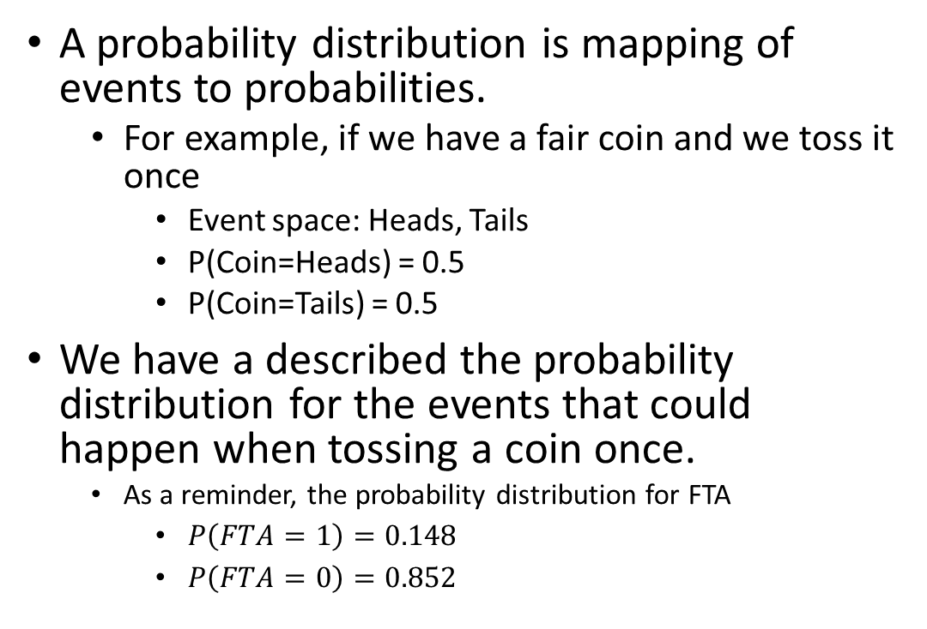
Probability Distributions
A probability distribution is mapping of events to probabilities.
For example, if we have a fair coin and we toss it once
Event space: Heads, Tails
P(Coin=Heads) = 0.5
P(Coin=Tails) = 0.5
We have a described the probability distribution for the events that could happen when tossing a coin once.
As a reminder, the probability distribution for FTA
$P\left(FTA=1\right)=0.148$
$P\left(FTA=0\right)=0.852$

